Slide 1
Introduction
Name- Ravi Shankar Prasad
Nationality- Indian
Department- Electronic and Computer Science
Bachelor in Electronics and Communication
Interest- Wireless Communication
Hobbies- Playing Badminton, Hiking, Soccer.

Slide 2
Schedule-
Week 4
Review research paper and understand methodologies.
Set up NS-3 simulator environment.
Explore sample simulations and configure environment.
Week 5
Identify key simulation parameters.
Draft simulation plan.
Begin coding initial framework for NS-3 simulation.
Initialization of p2pnodes,csmanodes and wifi nodes.
Week 6
Analyze preliminary results.
Checking results on wireshark and NetAnim.
Optimize simulation code for accuracy and performance.
Week 7
Document simulation process and results.
Prepare presentation slides summarizing findings.
Finalize presentation slides and practice delivery.

Slide 3

Topics Covered So far
■ Multimedia Applications ■ QoS Fundamentals ■ QoS Mechanisms ■ Classification ■ Channel Access Mechanism ■ Packet Scheduling Mechanisms ■ Traffic Policing Mechanism ■ Resource Reservation Signaling Mechanisms ■ Admission Control ■ QoS Architecture

Slide 4
QoS Mechanism
QoS Mechanism
In Traffic
Classification
Traffic Policing
Out of Traffic
Resource Reservation
Channel Access
Packet Scheduling
Admission Control
Traffic Handling Mechanism
Bandwidth Management Mechanism

Slide 5
QoS Architecture Applications may require different combinations of QoS mechanisms.
QoS Architecture
Quantitative QoS
Explicit Out of traffic
Strict In traffic
Qualitative QoS
QoS not Needed, Bandwidth for Best Traffic
Best Effort
In traffic exclusively depend on services
Out of Traffic

Slide 6
QoS Architecture for Infrastructure Wireless Networks
Resource Reservation
Classification
Traffic Policing
Packet Scheduling
Channel Access
Wireless Medium

Slide 7
Out of Traffic Mechanism- Resource reservation
Resource reservation signaling
Delivery QoS requirements to admission controller
Notification of the admission result.
RSVP operates on top of IP, in the transport layer
-Resource Reservation Protocol (RSVP)
- Supports Per class and Per flow reservation
Resource Reservation Mechanisms

Slide 8
Admission Control
Explicit admission control
decision is based on QoS requirements, available
resources, performance criteria, and network policy
Implicit admission control
relies on bandwidth over-provisioning and traffic control

Slide 9
In Traffic Mechanism- Classification
Can be per-user, per-flow, or per-class depending
on the type of QoS services provided

Slide 10
Research Paper
Wifi 10.1.3.0
AP
* * * *
| | | | 10.1.1.0 point-to-point
n5 n6 n7 n0 -------------- n1 n2 n3 n4
| | | |
================
LAN 10.1.2.0

Slide 11
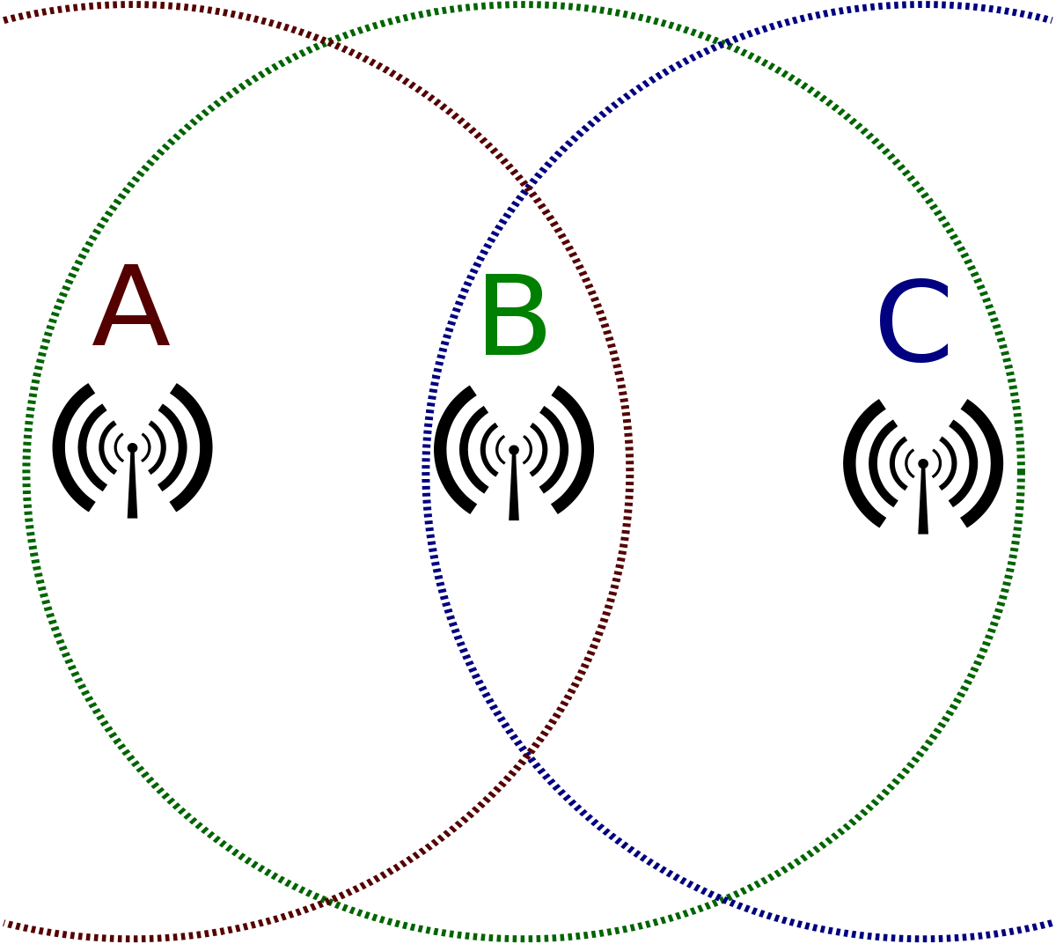
Wifi Hidden Nodes-
Topology-

Slide 12
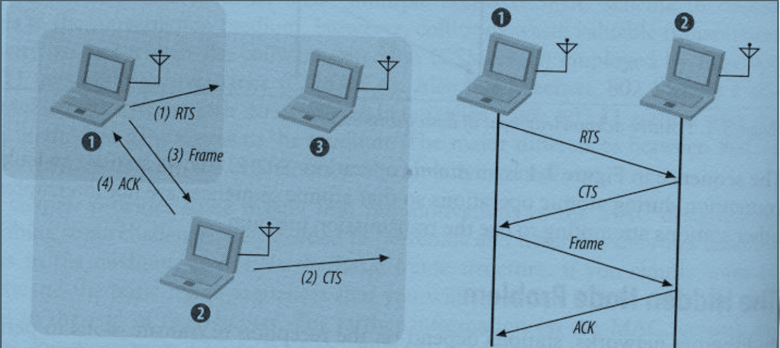
RTS and CTS
Request to send (RTS) and Clear to send (CTS) procedure.

Slide 13

Analyzing wireless Network 802.11 Using NS-3
ET5907701-Multimedia Wireless Networks
Ravi Shankar Prasad

Slide 14
Main Objective
Number of Nodes
Implementation of RTS/CTS
Distance between Nodes.

Slide 15

Tools Used
Ubuntu 22.04
NS-3.41
Wireshark
NetAnim
ASCII

Slide 16
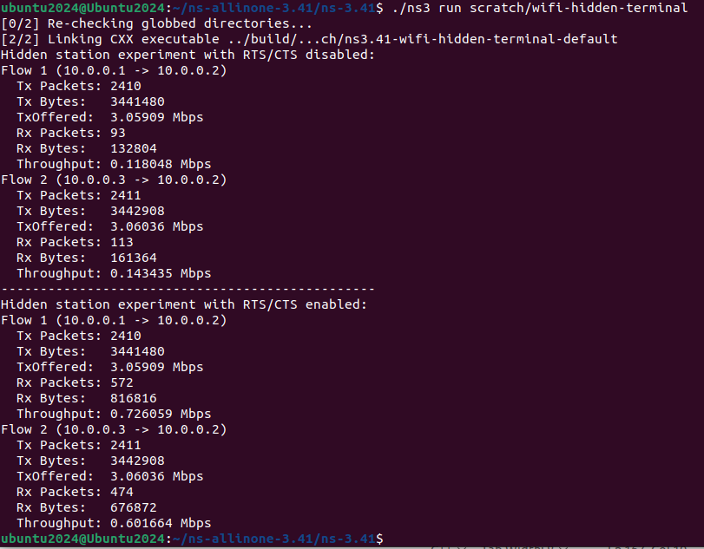
Throughput Calculation
Thoughput = (Total number of Packets * Packet size)/Total Time
First Simulation Results

Slide 17
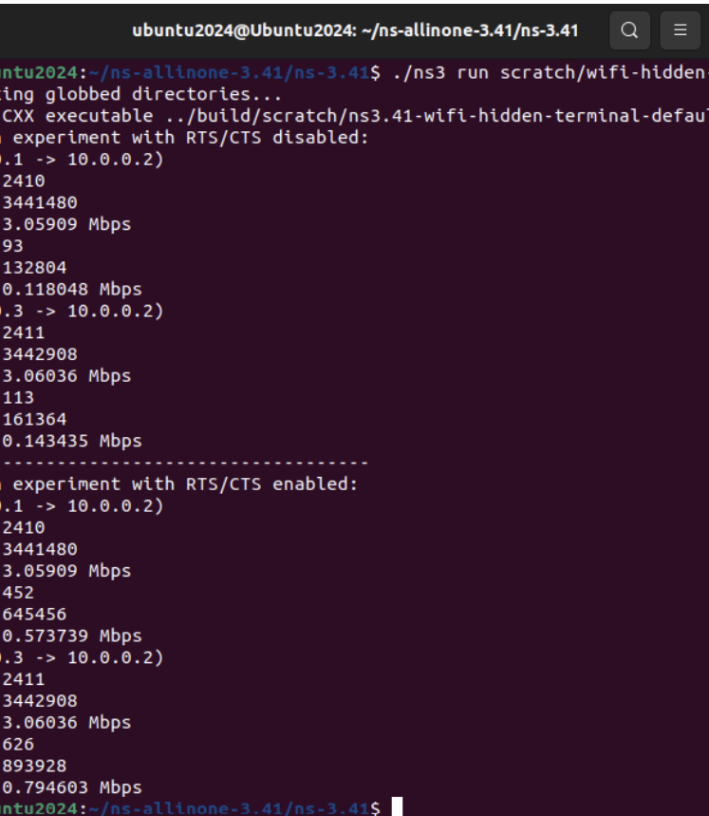
2nd Simulation Throughput

Slide 18
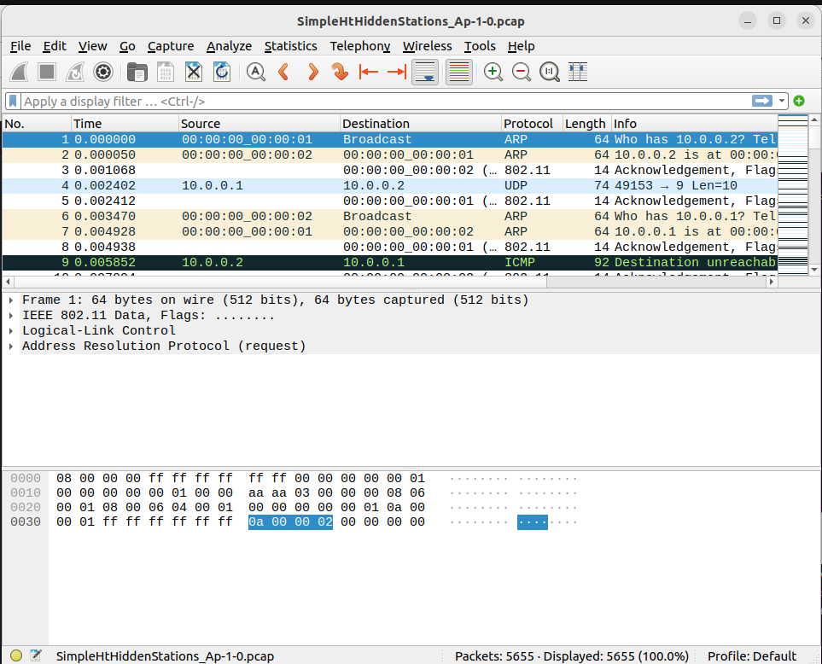
Wireshark output

Slide 19
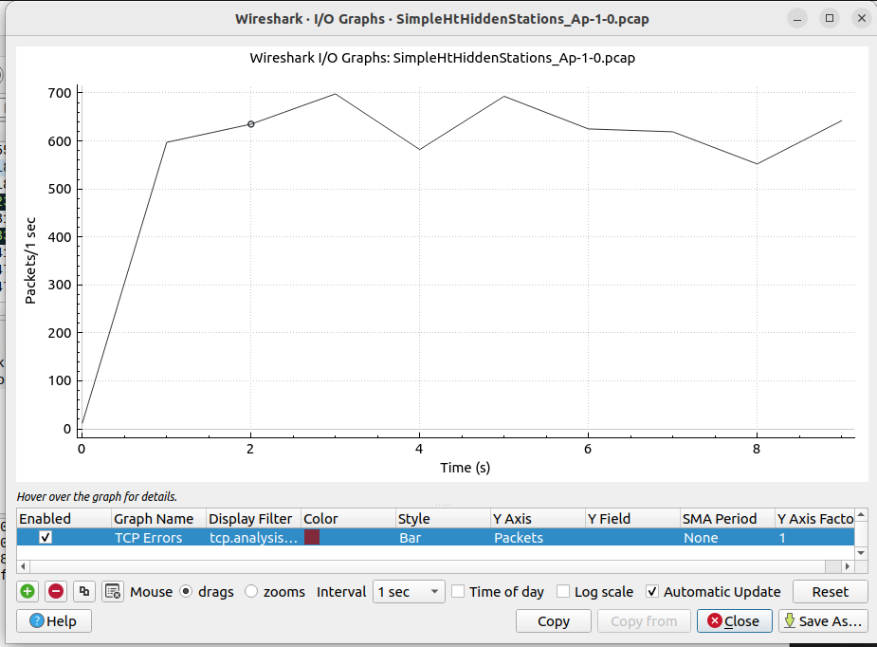
Wireshark I/O graph

